Slide 1
The Tower of Hanoi
By Section 2 Group 2

Slide 2
Group members:
Jwambe Joro Danjuma-20230867
Joseph Gana-241030095
Adie Prisca Omaku-20231550
Amina Fadila Wanka-241030226
Tukuru Desola-241030224
Oguntoye Oluwabusayomi-241030219
Isioma Oaikhena-20231375
Ruqayyah Kassim Hussain-241030220
Adindu Ozioma-20220129
Maimuna Babangida-20231958
Fawwaz Ajibola-20230853
Aisha Bala Mohammed-20230967

Slide 3
What is the Tower of Hanoi?
A classic mathematical/computer science problem that is widely used in AI to explain problem-solving, recursion and logical reasoning.
It was invented in 1883 by the French mathematician Edouard Lucas.
The problem consists of three vertical pegs (or rods) and a number of circular disks of different sizes. These disks are initially stacked on one peg in increasing order of size, with the largest disk at the bottom.

Slide 4
What is the Tower of Hanoi?
In solving the Tower of Hanoi there are strict rules that must be followed.
First, only one disk may be moved at a time.
Second, a disk can only be placed on top of a larger disk or on an empty peg.
Third, all movements must be made using the three pegs provided.

Slide 5
Major challenges in solving the Tower of Hanoi
Although the tower of Hanoi has simple rules and a clearly defined goal, it presents several challenges that are important in the study of Artificial intelligence and problem solving at large. The following are the problems related to the tower of Hanoi:

Slide 6
Major challenges in solving the Tower of Hanoi
The number of moves required to solve the problem grows at
(2n-12^{n} – 12n-1).
This exponential increase means that even moderately large problem instances require a very large number of steps. In AI, this highlights the difficulty of scaling solutions and the need for efficient algorithms that can manage large problem spaces.
Computational complexity

Slide 7
Major challenges in solving the Tower of Hanoi
Without a structured strategy such as recursion or planning, an agent may waste time exploring unnecessary or redundant states. This emphasizes the importance of intelligent control strategies and well-defined operators to guide the search process toward the goal state efficiently.
Search efficiency

Slide 8
Major challenges in solving the Tower of Hanoi
When modeled as a state-space search problem, storing and tracking visited states can consume significant memory, especially as the number of disks increases. This reflects real-world AI problems where memory constraints limit the feasibility of exhaustive search methods.
Memory Usage

Slide 9
Major challenges in solving the Tower of Hanoi
While the recursive solution is elegant, understanding how to decompose the problem correctly is not always intuitive for humans or intelligent agents. This reinforces the importance of abstraction and hierarchical problem-solving methods in Artificial Intelligence.
Problem decomposition difficulties

Slide 10
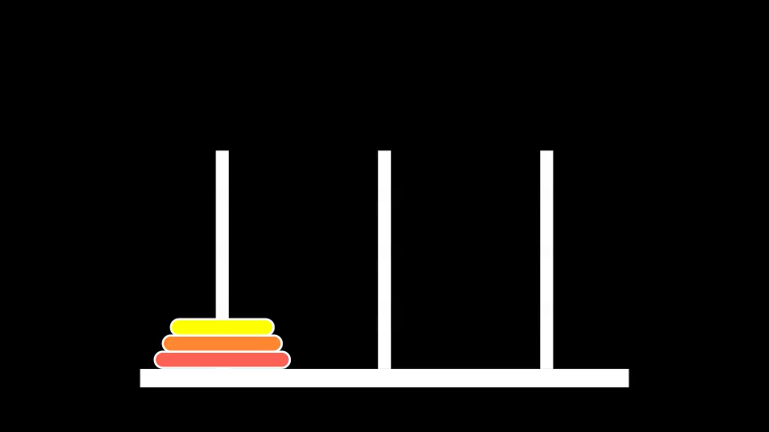
How to solve it

Slide 11
How to solve it
The key to solving the Tower of Hanoi problem lies in breaking the problem into smaller, manageable subproblems, a strategy known in Artificial Intelligence as problem decomposition. Instead of attempting to move all the disks at once, the problem is solved by focusing on moving smaller stacks of disks until the complete solution is achieved.

Slide 12
How to solve it
To move a stack of n disks from the source peg to the destination peg, the third peg is used as an auxiliary or temporary storage space.
The process involves three main steps.
  First, the top n − 1 disks are moved from the source peg to the auxiliary peg.
    This step reduces the original problem into a smaller instance of itself.
  Once the largest disk is free, it is moved directly from the source peg to the destination peg.
  Finally, the n − 1 disks are moved from the auxiliary peg onto the destination peg, placing them on top of the larger disk.

Slide 13
How to solve it
This strategy leads naturally to a recursive solution, which is a fundamental concept in both Artificial Intelligence and computer science.
In recursion, a problem is solved by repeatedly applying the same solution method to smaller versions of the problem. The base case occurs when there is only one disk to move. In that case, the solution is straightforward: the disk is moved directly from the source peg to the destination peg.

Slide 14
How to solve it
From an AI viewpoint, this solution can also be interpreted as a search problem. Each legal move represents a transition between states, and the goal is to find an optimal path from the initial state to the goal state.
The Tower of Hanoi has a known optimal solution, meaning the minimum number of moves required to solve the problem with n disks is:
2n−12^{n} - 12n−1
This formula highlights the concept of exponential growth, which is a major challenge in Artificial Intelligence. Even a small increase in the number of disks leads to a large increase in the number of required moves. For example, 3 disks require 7 moves, 4 disks require 15 moves, and 10 disks require 1,023 moves. This demonstrates why intelligent problem-solving strategies are necessary, as brute-force approaches become impractical for large problem sizes.

Slide 15
How to solve it
In practice, small instances of the Tower of Hanoi can be solved manually, but larger instances are best handled using computer programs. Implementing the solution in code helps visualize the recursive process and reinforces key AI concepts such as planning, state transitions, and algorithm efficiency.

Slide 16
Conclusion
The Tower of Hanoi is more than just a puzzle; it is a powerful model for understanding problem solving in Artificial Intelligence. It demonstrates how problems can be formally represented using states, actions, constraints, and goals, and how intelligent agents can systematically search for optimal solutions. Through its recursive structure and exponential complexity, the Tower of Hanoi provides valuable insight into algorithm design, efficiency, and the challenges of large state spaces. The lessons learned from this problem extend beyond the puzzle itself and apply directly to many real-world AI and computational problem-solving tasks.

Slide 17


